Slide 1




WFER Session 5d
Next generation of consumer growth
Tbilisi, Session 5d 24 Sept.2026

Slide 2


Judy Chang – Commissioner FERC
Judy Chang joined the Federal Energy Regulatory Commission as a Commissioner in July 2024.
Commissioner Chang is an energy economics and policy expert with more than 20 years of experience working with energy companies, trade associations and governments on regulatory and financial issues, including as former Undersecretary of Energy and Climate Solutions for Massachusetts.
Federal Energy Regulatory Commission

Slide 3


Clare Savage - Chair of Australian Energy Regulator
Clare Savage was appointed Chair of the Australian Energy Regulator in October 2019 and is Chair of the Energy Advisory Panel (formerly the Energy Security Board of which she was the Deputy Chair).
In over more than 21 years, Clare has acquired significant leadership experience in the Australian energy industry, holding senior executive positions within Energy Australia.

Slide 4


Luca Lo Schiavo
Energy Regulators Regional Organisation
Luca is a senior regulatory specialist and leads the Research Unit at ERRA, following a long career at the Italian Regulatory Authority for Energy Networks and Environment (ARERA) where he served as Director of the Market Monitoring and Energy System Services Directorate and Deputy Director of the Energy Infrastructure Regulation Directorate.

Slide 5


Siti Safinah binti Salleh
CEO of the Energy Commission of Malaysia
Safinah has 20 years of experience in network industries and investment (telecoms, digital economy). She is Chief Executive Officer of the Energy Commission (Suruhanjaya Tenaga) since 19 February 2025.
Prior to this role, she served as Chief Executive Officer of MyPOWER Corporation, where she led the coordination and implementation of power supply industry reform initiatives in Malaysia.

Slide 6
WFER Session 5d
Next generation of consumer growth
Tbilisi, Session 5d 24 Sept.2026

Slide 7
Clare Savage
Chair Australian Energy Regulator

Slide 8
Next Generation of Consumer Growth
Clare Savage, Chair, Australian Energy Regulator

Slide 9
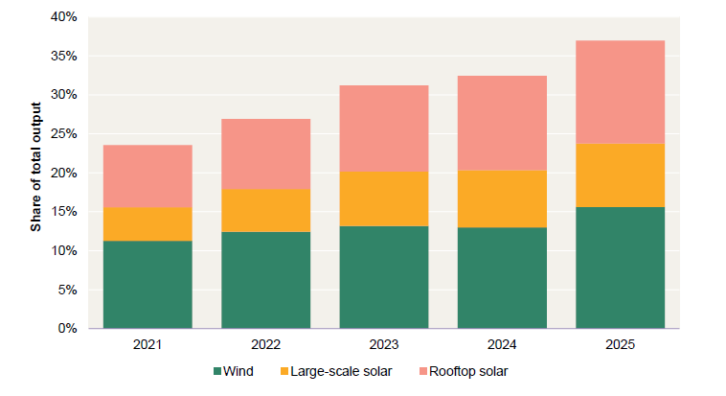
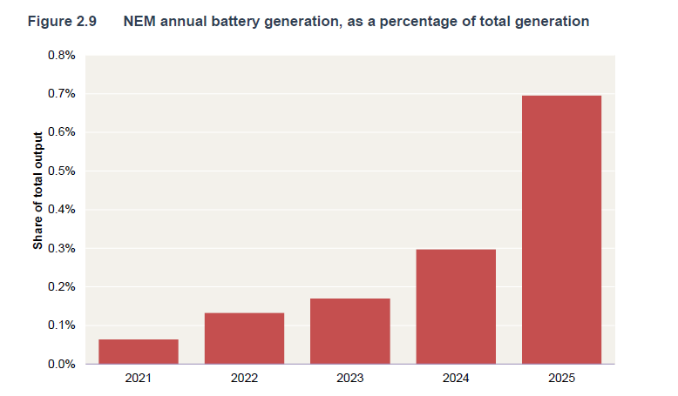
Australia’s generation mix continues to shift towards intermittent renewables and storage
NEM annual wind and solar generation, as a percentage of total generation
NEM annual battery generation, as a percentage of total generation
Source: AER Wholesale electricity market performance report 2026, Figures 2.8 & 2.9

Slide 10
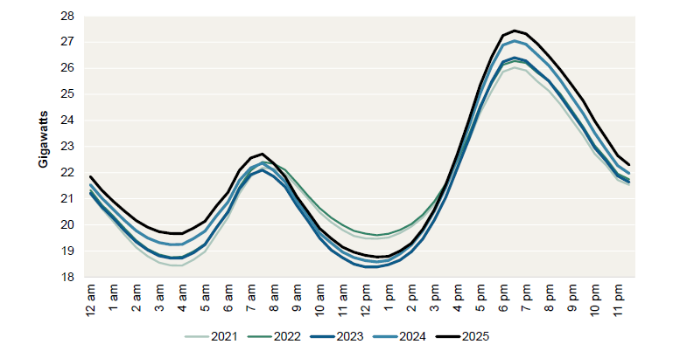
Demand continues to increase at all times of the day, particularly outside the daytime
Average NEM native demand, by time of day
Source: AER Wholesale electricity market performance report 2026, Figure 2.11

Slide 11
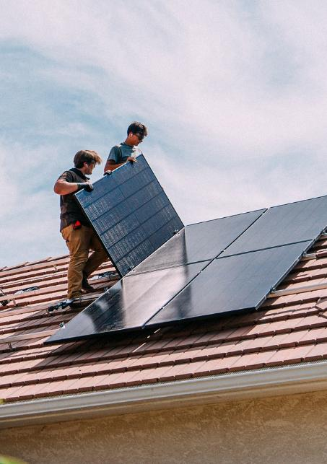
Large customers pose challenges and opportunities for the system
Data centre usage is projected to increase seven fold over the next decade and to grow from 3% to 13% of operational demand
New Government Small-Scale Renewable Energy Scheme to expand from 100kW to 1MW.
Ensure generation, firming, network capacity and system services are available in the right locations at the right times.
1
Build firm capacity
2
Considering locational signals
3
Allocate costs efficiently
4
Improve visibility and coordination

Slide 12

Time of use and two-way tariffs can help manage the impact of EV charging on our electricity networks
The AER has approved two-way tariffs that reward customers when their vehicle-to-grid (V2G) enabled electric vehicles send electricity back to the grid, encouraging wider use of bidirectional charging.
Dynamic tariffs and flexible load tariffs, currently being trialed in New South Wales, provide additional ways for networks to send customers price signals that help support the grid.

Slide 13
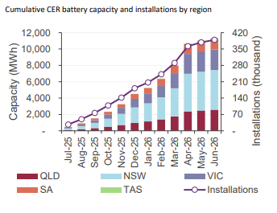
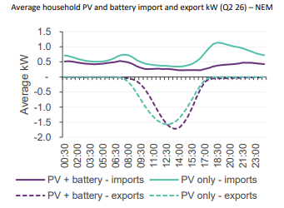
Small customers with access to CER are accelerating and supporting the transition
Australian Government’s Cheaper Home Batteries program has supported more households to install batteries
Households with solar and batteries shift their exports into later in the day and reduce their imports during peaks
Source: AEMO QED report q2 2026, Figure 9
Source: AEMO QED report q2 2026, Figure 10

Slide 14
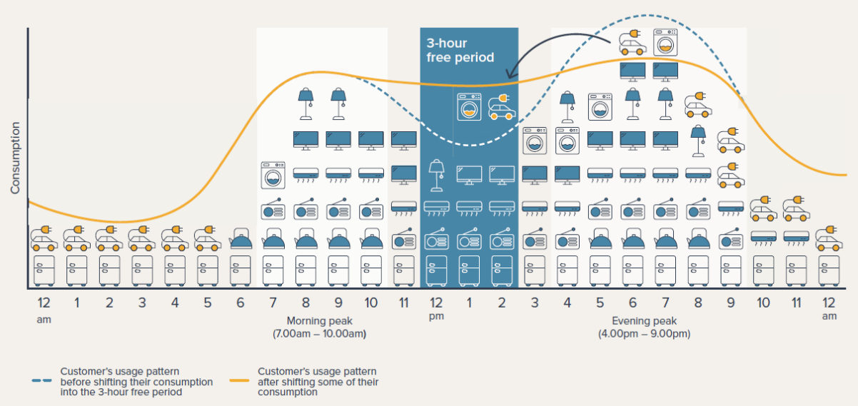
Ensuring those consumers without CER can benefit from the transition, and are protected
The Solar Sharer Offer is an opt-in energy offer that provides eligible households with 3 hours of free electricity in the middle of the day.

Slide 15
WFER Session 5d
Next generation of
consumer growth
Luca Lo Schiavo
ERRA Research Unit
Tbilisi, session 5d 24 Sept.2026

Slide 16
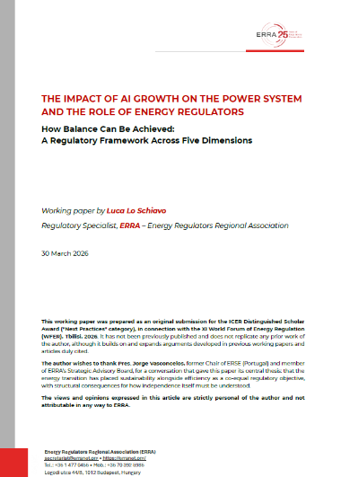
ERRA Research Paper: The Impact of AI Growth on the Power System
Four substantive dimensions
long-term predictability
operational reliability
economic affordability
and environmental sustainability
regulatory independence, that cuts across all four: the institutional condition that determines whether (and which) governance of the other four is possible at all
A fifth dimension
ICER Distinguished Scholar Award Winner
in the Next Practices Category (WFER 2026)
https://erranet.org/research-papers/

Slide 17
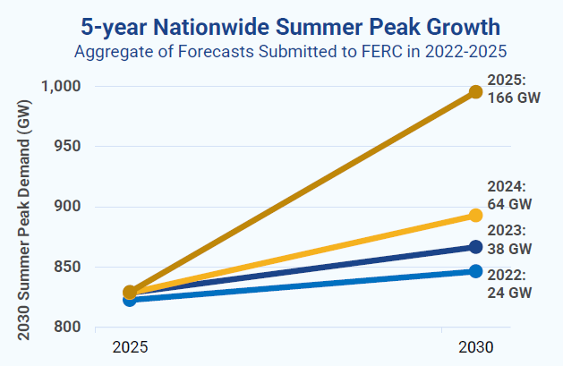
Long-term forecast predictability (“quantity” of demand)
FERC Forecast Revision Timeline
2022 24 GW — base scenario; AI not yet recognised as a demand driver
2023 38 GW — first significant upward revision; ChatGPT reshapes market expectations
2024 ~80 GW — hyperscalers multiply interconnection requests across all utility territories
2025 166 GW total, of which 90 GW
from data centres.
ENTSO-E EU network plan 2026:
EU data centre demand ×3 by 2030 vs. 2019
Source: Grid Strategies, Power Demand Forecasts Revised Up for Third Year Running, Led by Data Centers, Nov. 2025

Slide 18
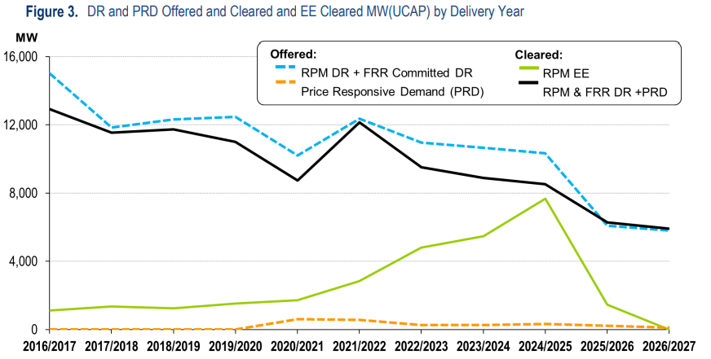
Limited or null demand flexibility (“quality” of demand)
PJM Base Residual Action
PRD Price Responsive Demand: remains extremely small (orange dotted line)
Source: PJM, Base residual auction report, Jul. 2025

Slide 19
Long-term forecast predictability: reasons for gaps
Five critical variables
Utilities forecasts
vs. Independent Analysts
Utility projections
(filed with FERC): 90 GW
Independent
analyst estimates: 65 GW
25 GW gap = +40% overestimation
≈ 2× New York City peak ·
≈ ½ Italy's national peak
1. Project realisation rate (will it actually be built?)
2. Actual vs. contracted load (peak ≠ average consumption)
3. Commercial operation date (can be delayed by months/years)
4. Ramp-up curve (not instantaneous)
5. Hourly load factor (training vs. inference profiles differ radically)
Source: Grid Strategies, Power Demand Forecasts Revised Up for Third Year Running, Led by Data Centers, Nov. 2025

Slide 20
Lessons learnt and good practices
① Standardised, transparent methodologies
The Capex bias:
Under cost-of-service regulation, overestimating is rational
Under this kind of regulation, utilities earn returns proportional to their rate base. Overestimating demand is not an error — it is the rational outcome of a misaligned incentive structure.
Probabilistic, not deterministic, planning assumptions.
Unified methodology with five mandatory metrics (realisation rate, load factor, date, ramp-up, cancellation probability).
② Regulatory incentives matter
“Least regret” criterion among different scenarios when calculating optimal capacity (*)
Output-oriented, rather than asset-based, regulatory incentive framework
③ Flexibility is not a luxury
In the EU, the Commission's Grid Package connection guidelines (2025) still need implementation
(*) A full example of application of “least regret” criterion: ESIG Large Loads Task Force, Transmission Planning with Large Loads, Current Practices and Recommendations, Jul. 2026. pp. 31-33

Slide 21
The Regulatory Toolkit
Lovins proposal
MANDATORY BONDING
Risk price discovery applied to demand-side infrastructure.
Bond markets price what regulators cannot: the real probability that forecast demand materialises.
Ireland CRU
BRING YOUR OWN GENERATION
Large load brings the capacity it needs — instead of requiring the system to build it.
Cost allocation radically different; system adequacy identical.
Combined with mandatory use of RES for 80% of time (Dec-25 decision)
US PJM
NON BACKED CAPACITY LOAD
Large loads can be interrupted in case of system stress
They are exempted to pay capacity market price component
Discrimination effect
Spain
CONCURSO DE DEMANDA
Environmental based score. Replaces First Come First Served principle
Renewables, flexibility, and low carbon commitment are rewarded.
Formally non-discriminatory — differentiates by objective policy criteria, not identity
ERRA organizes a workshop on AI Data Center impact on Power Systems and the role of Regulators
Athens, Oct. 27 2026
https://erranet.org/erra-workhop-on-power-systems-and-the-growth-of-ai-data-centers/

Slide 22
luca.loschiavo@erranet.org
101. (…) Current AI systems require enormous amounts of energy and water, significantly influencing carbon dioxide emissions, and place heavy demands on natural resources. As their complexity increases, especially in the case of large language models, the need for computing power and storage capacity grows too, which requires an extensive network of machines, cables, data centers and energy-intensive infrastructure. For this reason, it is essential to develop more sustainable technological solutions that reduce environmental impact and help protect our Common Home.
Encyclical Letter MAGNIFICA HUMANITAS
of His Holiness Pope Leo XIV

Slide 23
WFER Session 5d
Next generation of consumer growth
Tbilisi, Session 5d 24 Sept.2026

Slide 24
WFER Session 5d
Next generation of consumer growth
Tbilisi, Session 5d 24 Sept.2026

